Slide 1




Hexaware CODE&RISE PROGRAM
HexaQuadraletsdo
Empowering Your Professional Growth

Slide 2

Team Details
Team Name:HexaQuadraletsdo
Application Name:Soft Skill Enhancement Platform
Team Members
Email ID
Dharshini J
dharshini1212004@gmail.com
Gayathri N
gayathri13823gs@gmail.com
Mounika V
mounikav2004cse@gmail.com
Vinoth Kumar P
samvinoth25@gmail.com

Slide 3

Impact/Potential Value of the Application
Career Advancement:
Improved employability: Strong soft skills are highly sought after by employers, increasing job prospects and career advancement opportunities.
Enhanced negotiation skills: Effective communication and problem-solving can help employees negotiate better salaries, promotions, and benefits.
Increased leadership potential: Developing leadership skills can position employees for management roles and increased responsibilities.
Job Performance:
Improved productivity: Employees with strong soft skills are often more efficient and effective in their roles.
Enhanced teamwork and collaboration: Effective teamwork can lead to better problem-solving, innovation, and overall performance.
Better conflict resolution: Strong conflict resolution skills can help to prevent and resolve disputes within the organization.
Personal Growth:
Enhanced interpersonal relationships: Effective communication, teamwork, and problem-solving can lead to better relationships with colleagues, friends, and family.
Increased self-confidence: Developing soft skills can boost self-esteem and confidence in personal and professional interactions.
Lifelong learning: The application can foster a culture of continuous learning and personal growth.
Work-Life Balance:
Reduced stress: Effective time management and stress management skills can help employees balance their work and personal lives.
Improved job satisfaction: Employees who feel valued and supported are more likely to be satisfied with their jobs.

Slide 4
The Solution Proposed by our Team
Solution Highlights:
1.Personalized Learning:
Adaptive content to adjust difficulty and pace.
Interactive and Engaging:
2:Comprehensive Skill Development:
Focus on a wide range of soft skills, including communication, teamwork, problem-solving, and leadership.
3.Practical Application:
Integration with workplace tools for direct application of learned skills.
4.Community and Support:
Peer-to-peer learning and networking opportunities.
Supportive community for motivation and encouragement.
5.Technology-Driven:
Modern frontend and backend frameworks for a seamless user experience.
Cloud-based hosting for scalability and accessibility.
Gamification tools for interactive learning experiences.
Key Features / Approach
Learning path customizable by HR
Provides practice test
detailed test reports
4. tracks progress
5. Personalized Learning
6. Interactive and Engaging
7. Comprehensive Skill Development
8. Practical Application
9. Community and SupportTechnology-Driven

Slide 5
Technologies Used
Core Technologies:
1.Generative AI Models:
Large Language Models (LLMs): GPT-3, GPT-4, or similar models for generating text-based content, providing explanations, and answering questions.
Dialog Systems: Models specifically designed for conversational interactions, such as those used in chatbots or virtual assistants.
Natural Language Processing (NLP)
2.Frontend:
React or Vue.js
CSS Frameworks: Bootstrap, Material UI, or Tailwind CSS for styling and layout.
3.Backend
Node.js
Python
4.Frameworks: Django, Flask, or FastAPI for web application development.
5Cloud Platform:AWS, Azure
6.
NoSQL Databases: MongoDB or Cassandra for flexible data storage and scaling.
Relational Databases: PostgreSQL or MySQL for structured data.
AI Integration:
AI Frameworks
Hugging Face Transformers: A library for pre-trained language models.
API Integration:
Integrate pre-trained generative AI models through APIs (e.g., OpenAI's GPT-3 API).
Custom Model Training: For specific use cases, train custom models on relevant datasets.

Slide 6
Gen AI Tool Utilization
1.Large Language Models (LLMs): GPT-3, GPT-4, or similar models for generating text-based content, providing explanations, and answering questions.
2.Dialog Systems: Models specifically designed for conversational interactions, such as those used in chatbots or virtual assistants.
3.Natural Language Processing (NLP):
Text Analysis: Techniques for extracting meaning, sentiment, and intent from text data.
4.Question Answering: Systems capable of answering user questions based on a given knowledge base.

Slide 7
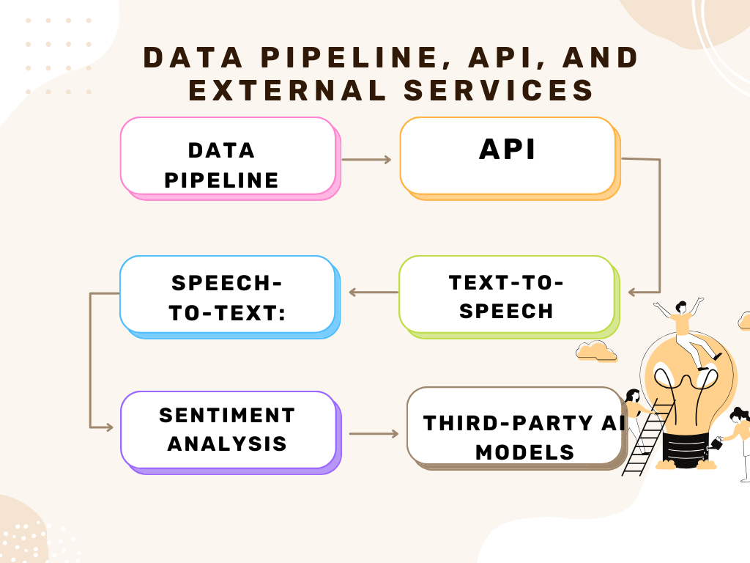
System Architecture, Functionalities and Design Diagram

Slide 8

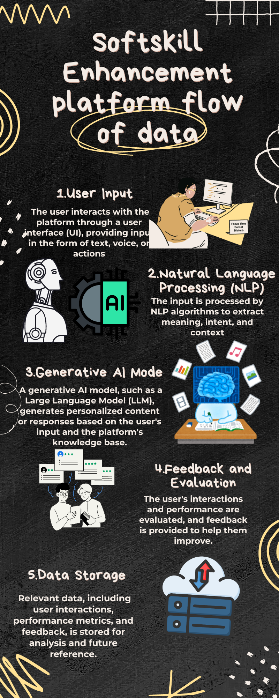

Slide 9
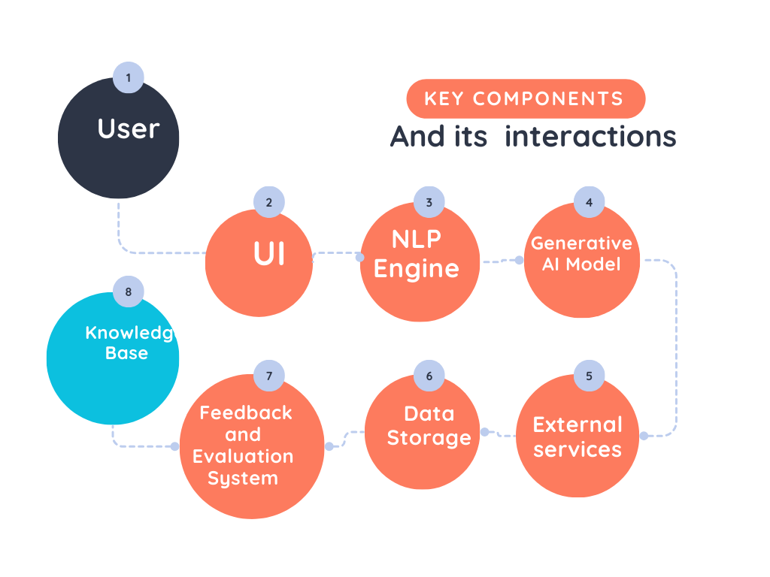

Slide 10
HOW IT WORKS
Functional Architecture
1. User Interaction and Authentication
Login/Registration Process
User Dashboard Access
2. Personalized Learning Paths
AI-Driven Content Personalization
Real-Time Progress Adaptation
3. Lesson Engagement and Feedback
Interactive Lessons (Vocabulary, Speech, Pronunciation)
Real-Time AI Feedback
4. Practice Tests and Assessments
Automated Test Evaluation
Performance Reporting and Insights
5. AI-Powered Content Generation
Dynamic Lesson Creation
Adaptive Learning Content
6. Data Flow and System Integration
Data Pipeline: Frontend to Backend
API Interactions and External Services
7. Cloud Hosting and Scalability
Infrastructure Support
Integration with External APIs
8. Security and Data Privacy
Data Protection Protocols
Role-Based Access Control

Slide 11
HOW IT WORKS
Technical Architecture
5. Data Pipeline
Real-Time Data Processing Workflow
API Endpoints for AI/ML Services
Data Storage and Retrieval Process
6. External Services and Cloud Infrastructure
Cloud Hosting and Scalability
CI/CD Pipeline Integration
Monitoring and Performance Optimization
7. Security and Compliance
Data Encryption and Secure Transmission
Role-Based Access Controls
Audit Logging and Monitoring
1. User Interface (UI) Interaction
Frontend Architecture (React.js)
Role-Based Access Control and Navigation
2. Backend Services
API Gateway and Routing (Node.js/Express)
Authentication and Authorization Mechanisms
Session Management and Security
3. Data Management
Database Architecture (MongoDB)
Data Flow Between Frontend, Backend, and Database
Data Persistence and Retrieval
4. AI/ML Integration
AI Model Deployment (Python/Flask)
Speech Recognition and Text Analysis
Generative AI for Content Creation

Slide 12
Innovation and Creativity
1.Innovation and Creativity in Our Platform
AI-Driven Personalization: Tailors learning paths dynamically using AI, ensuring content adapts to individual user needs and progress.
2.Generative AI for Content Creation: Automatically generates unique exercises, quizzes, and scenarios, offering a fresh and engaging learning experience.
3.Advanced Speech Recognition: Provides real-time feedback on pronunciation, enabling personalized improvement in speaking skills.
4.Gamification and Engagement: Uses gamification techniques and responsive UI/UX design to make learning more interactive and motivating.
5.Scalable Cloud Architecture: Employs innovative cloud solutions for seamless scalability and flexibility, ensuring the platform grows with its users.
6.Inclusive and Adaptive Learning: Supports multilingual content and adjusts learning paths to accommodate diverse user backgrounds and needs.

Slide 13

Scalability, Performance and Security
Scalability:
Cloud Infrastructure: Utilizes cloud platforms (AWS, Azure) for dynamic scaling, ensuring the platform handles increasing user loads seamlessly.
Microservices Architecture: Modular design allows independent scaling of components, optimizing resource use.
Database Scaling: MongoDB Atlas supports horizontal scaling to manage large volumes of data efficiently.
Performance:
Load Balancing: Distributes traffic across servers to prevent bottlenecks and maintain fast response times.
Caching Mechanisms: Implements caching at various layers to reduce latency and improve data retrieval speeds.
Real-Time Data Processing: Efficient API endpoints and optimized data pipelines ensure quick, real-time feedback and content delivery
Security:
Data Encryption: Uses SSL/TLS for secure data transmission and encryption of sensitive information in the database.
Role-Based Access Control (RBAC): Ensures that users only have access to the data and features relevant to their role.
Compliance: Adheres to industry standards (e.g., GDPR) for data protection and user privacy, with regular audits and monitoring in place.

Slide 14
Best practices and industry standards followed
1.User-Centric Design:
Consistency: Maintain uniformity in design elements and navigation.
Clarity: Ensure clear, intuitive layouts with actionable insights.
Accessibility: Follow WCAG guidelines for color contrast, font size, and keyboard navigation.
2.Performance Optimization:
Load Time: Optimize assets and data queries to minimize loading times.
Responsive Design: Ensure compatibility across devices and screen sizes.
Scalability: Design for future expansion and handle large data volumes efficiently.
Data Visualization:
3.Relevance: Use appropriate charts and graphs to convey key metrics.
Simplicity: Avoid clutter; focus on actionable and relevant data.
Interactivity: Provide filtering and drill-down options for detailed insights.
4.Security & Privacy:
Authentication: Implement robust authentication and authorization protocols.
Data Protection: Encrypt sensitive data and comply with GDPR/CCPA standards.
Regular Updates: Keep software and dependencies updated to address vulnerabilities.
5.Feedback & Iteration:
User Feedback: Regularly gather and incorporate user feedback to improve usability.
Continuous Improvement: Iterate on design based on performance metrics and user interactions.

Slide 15

User Experience
1. Intuitive Navigation:
Clear Structure: Use familiar navigation patterns and labels.
Quick Access: Ensure key features and data are easily accessible.
2. User-Centric Design:
Personalization: Tailor content and recommendations based on user preferences and behavior.
Responsiveness: Design for various devices and screen sizes to enhance accessibility.
3. Data Presentation:
Clarity: Use clear, concise data visualizations with appropriate chart types.
Focus: Highlight key metrics and insights; avoid information overload.
4. Interactive Elements:
Real-Time Updates: Display live data and notifications where relevant.
Interactive Filters: Allow users to customize views and drill down into details.
5. Performance & Efficiency:
Speed: Optimize for fast load times and smooth interactions.
Scalability: Ensure the dashboard performs well with increasing data and user load.
6. Accessibility:
Compliance: Follow accessibility guidelines (WCAG) for users with disabilities.
Keyboard Navigation: Ensure all interactive elements are accessible via keyboard.
7. Feedback Mechanisms:
User Input: Provide easy ways for users to give feedback or report issues.
Iterative Improvement: Regularly update the design based on user feedback and performance data.
8. Security:
Data Protection: Implement strong security measures to safeguard user data.
Authentication: Use secure login methods and access controls.

Slide 16
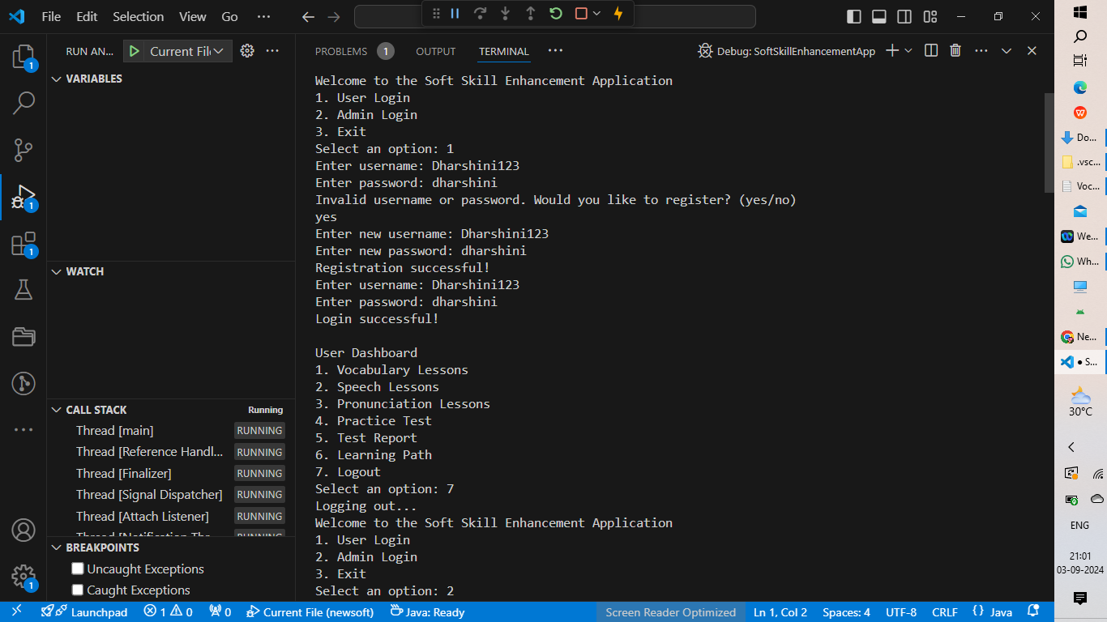
Console Output Details
.

Slide 17
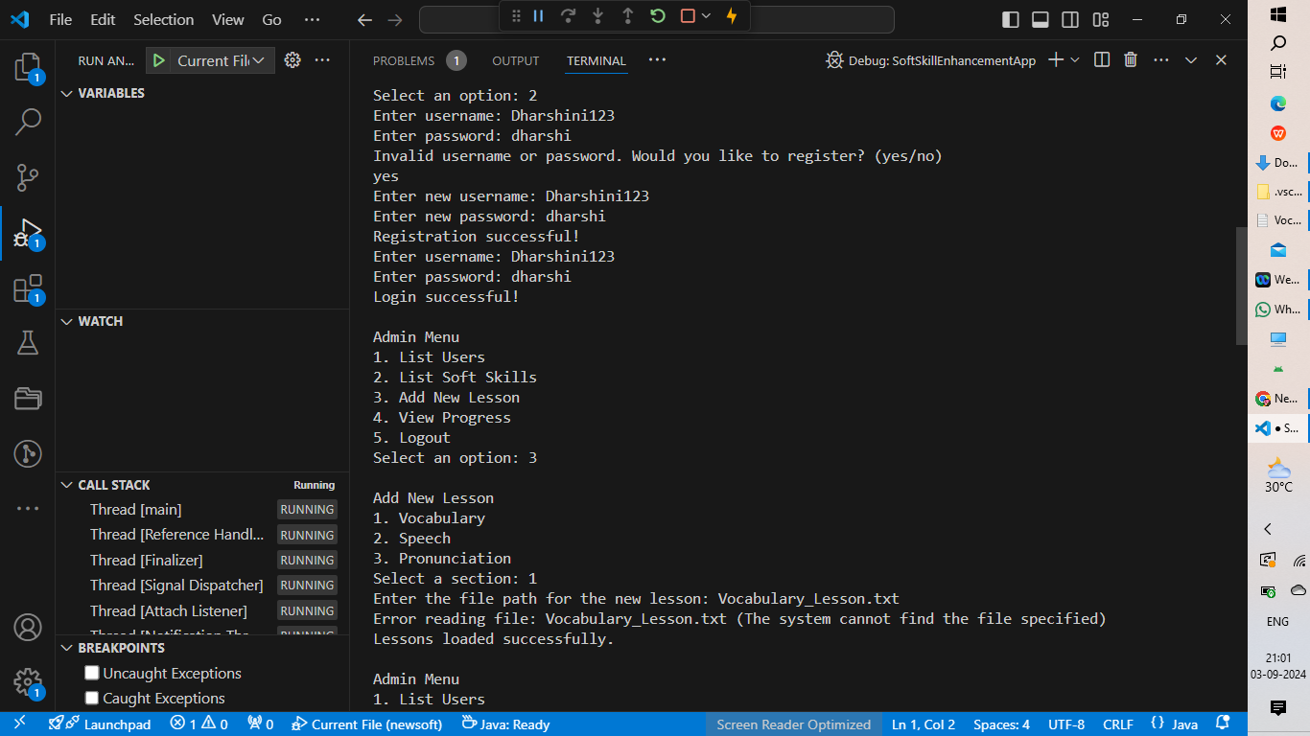

Slide 18
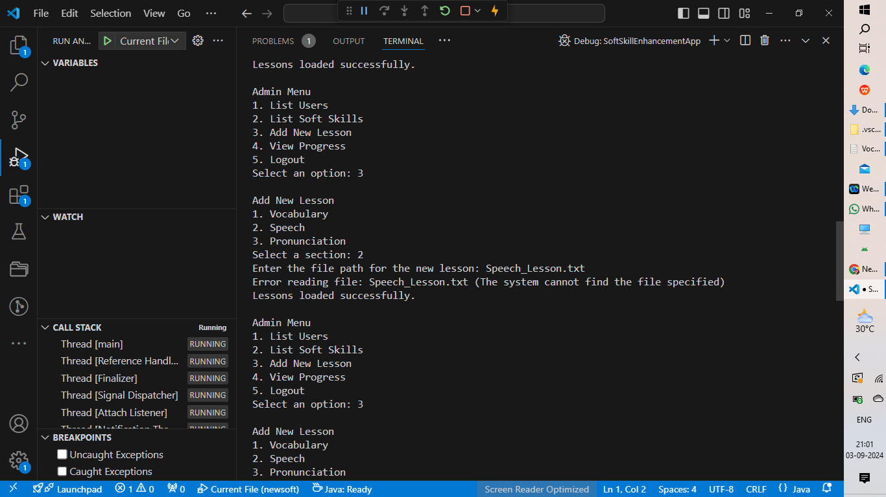

Slide 19
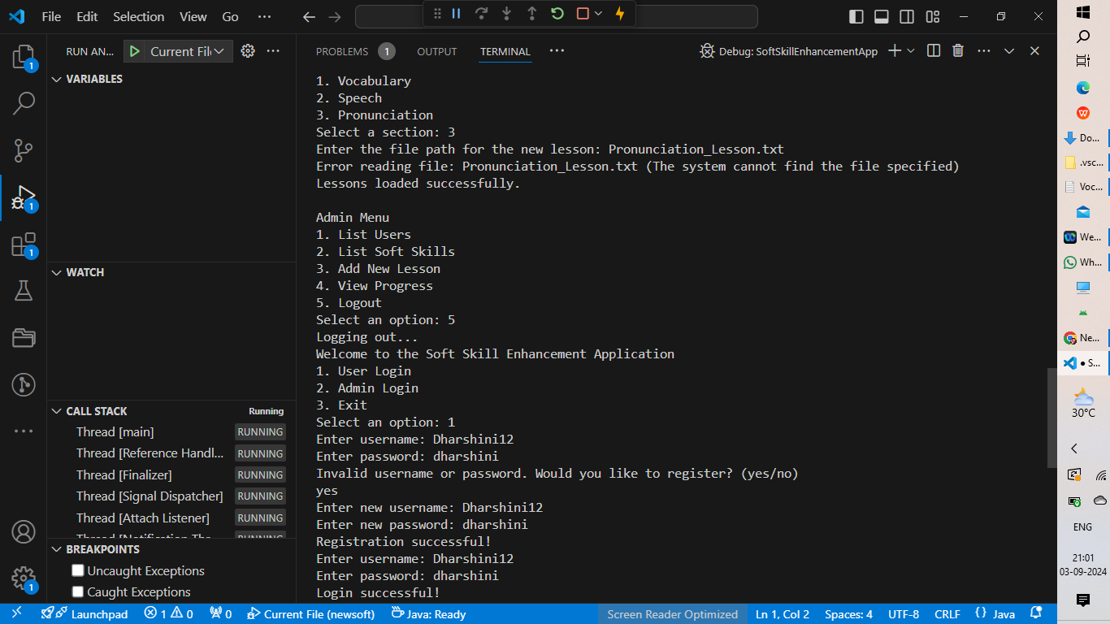

Slide 20
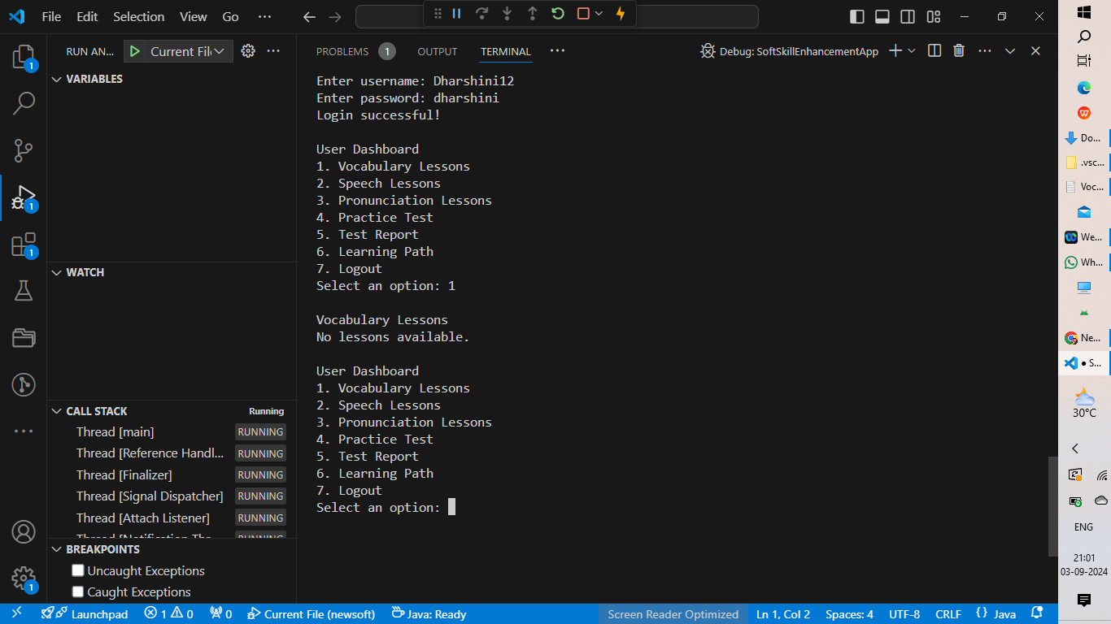
GITHUB Link:https://github.com/1212004/softskillenhancementplatform.git

Slide 21


